Slide 1

TWITTER SENTIMENT ANALYSIS FOR US ELECTIONS
TEAM MEMBERS
2010030374 – JAIDEEP SHARMA
2010030413 – NIHAL AGARWAL
2010030361 – T VENKATA SAI SATHVIK
2010030153 – SHAIK ABDUL SHAAN
DATA VISUALIZATION AND TECHNIQUES

Slide 2
TABLE OF CONTENTS
S. No. | TITLE | Slide No.
1 | PROJECT AREA | 3
2 | LITERATURE SURVEY | 4
3 | PROBLEM STATEMENT | 6
4 | DATASET COLLECTION | 7
5 | CODE IMPLEMENTATION | 8 – 16
6 | OUTPUT | 17 - 19
7 | GITHUB REPOSITORY | 20
8 | CONCLUSION | 21

Slide 3
PROJECT AREA
The main aim for selecting this project is to analyse the sentiments and visualize the polarity of comments, whether it is a negative, positive or neutral so that it can lead to better result prediction.

Slide 4
LITERATURE SURVEY
Sno | Author | Title | Publishing | Techniques and datasets | Pros | Cons
1. | Rao hamza ali, gabriela pinto, evelyn lawrie & erik J. Lin stead | A large-scale sentiment analysis of tweets pertaining to the 2020 US presidential election | Journal of big data | Donald trump, trump, biden, joe biden, biden. Vader model. | Analysis on all tweets for us 2020 elections between biden and trump. | Sarcasm was not detected by this model which uses VADER.
2. | Ussama yaqub, soon ae chun, vijayalakshmi atluri, jaideep vaidya | Sentiment based analysis of tweets during the US presidential elections | Research gate | Sentiment analysis, social media, behaviour analysis, elections. | Analysed approximately 3 million twitter messages associated with US presidential elections of 2016. | Some tweets were accurate while some were hard to analyse.

Slide 5
LITERATURE SURVEY
Sno | Author | Title | Publishing | Techniques and datasets | Pros | Cons
3. | Manch hui, devlikamov vlad, harikrishna C. | Sentiment analysis on US election 2020 tweets. | Kaggle | Sentiment analysis, social media, behaviour analysis, elections. | Tweets collected, using the twitter API statuses_lookup and snsscrape for keywords, with the original intention to try to update this dataset daily so that the timeframe will eventually cover 15.10.2020 and 04.11.2020 | The dataset has a lot of messy data as some of the attributes don’t get converted into needy ones.
4. | Alexander shevtsov, maria oikonomidou, despoina antonakaki, polyvios pratikakis, sotiris ioannidis. | Analysis of twitter and youtube during uselections 2020 | Arxiv | Online social networks, twitter, youtube, sentiment analysis | It demonstrates sentiment analysis on the twitter corpus and the youtube metadata and shows that the positive sentiment is higher for donald trump in comparison with joe biden. | Sarcasm was not detected by this model

Slide 6
OBJECTIVE
By reviewing the previous published paper, the main problem is the model cant detect the sarcastic comments, so we are using state vector machine in NLP to detect the sarcasm and the polarity check using Text Blob and random forest.

Slide 7
PROBLEM STATEMENT
The classification of twitter data based on tweets aims to provide efficient and accurate graphical representation of likes, tweets and favor in US presidential elections using sentiment analysis and deriving visualization graphs from it. There are different users who has tweeted either for Trump to win or Biden to win and other users has retweeted it either supporting or rejecting. Based on all these tweets we can derive a final graph and analysis whether Trump or Biden is going to win US presidential elections hypothetically according to people’s views and thoughts. This metadata serves the purpose of helping community to filter relevant opinions more efficiently.

Slide 8
DATASET TO BE USED
https://www.kaggle.com/datasets/manchunhui/us-election-2020-tweets

Slide 9
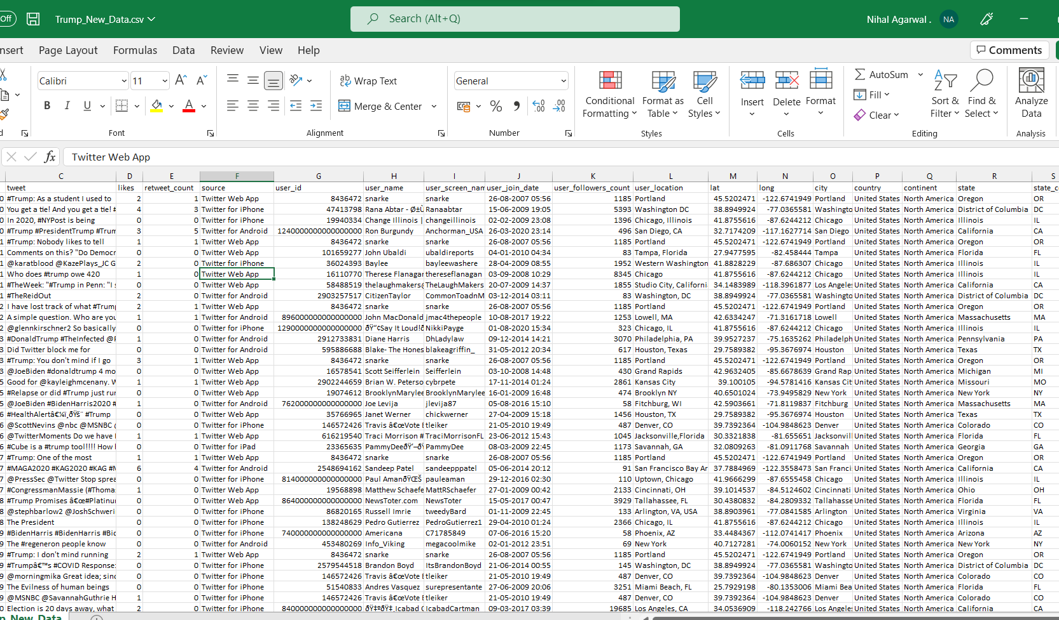
TRUMP DATASET

Slide 10
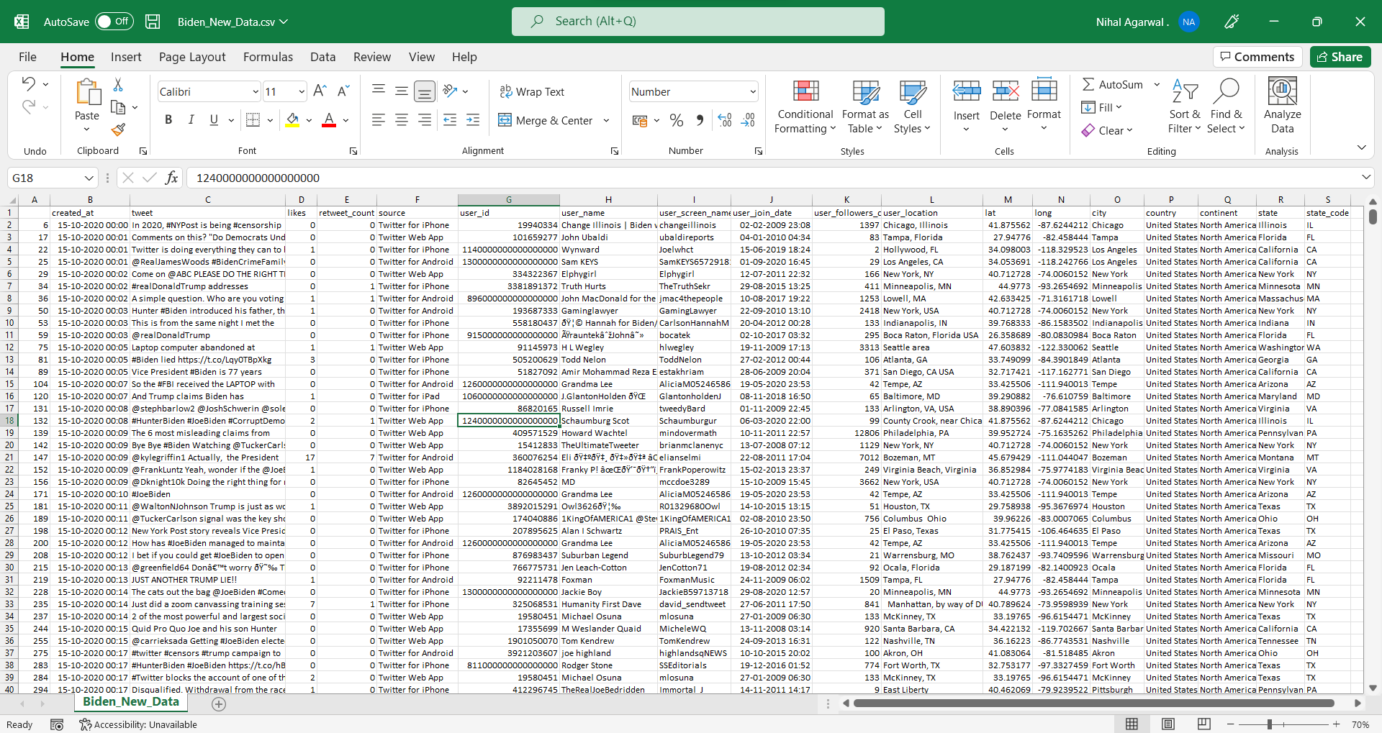
BIDEN DATASET

Slide 11
WORK PROGRESS
Importing dataset and libraries needed for analysis.
Importing all natural language tool kit libraries for data cleaning and model evaluation.
Skimming and scanning the datasets and understanding the distribution in the data.
Cleaning the dataset initially - removing null values, and unwanted columns that doesn't help in our analysis and dropping them.
Sorting the values from first date of tweet and first time of tweet to last date of tweet to last time of tweet.
Then visualize the tweets only from United states country, we have all types of countries , so filter the united states and replace them to Whole Us data and join them at that axis.
Then count the Tweets from each city in US and group them in ascending order and prepare a data Frame for them to understand the distribution.
Based on the number of states visualize the graph between states vs no of tweets.
Clean the data for analysis.

Slide 12
CODE IMPLEMENTATION

Slide 13
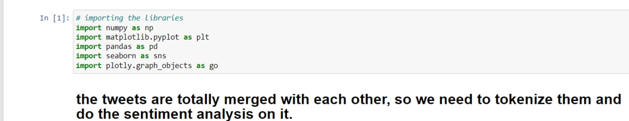
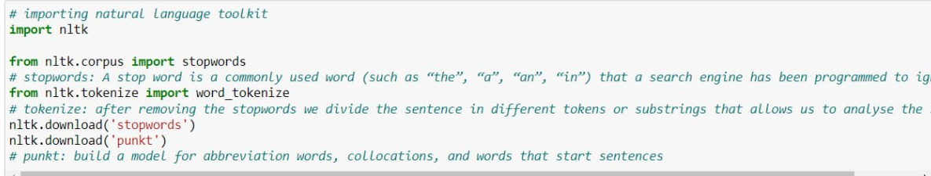
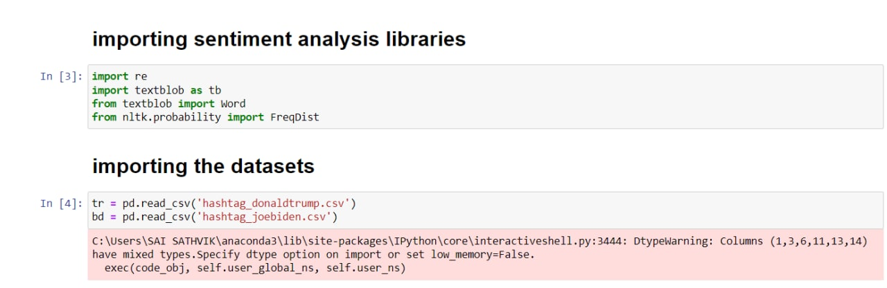
CODE IMPLEMENTATION

Slide 14
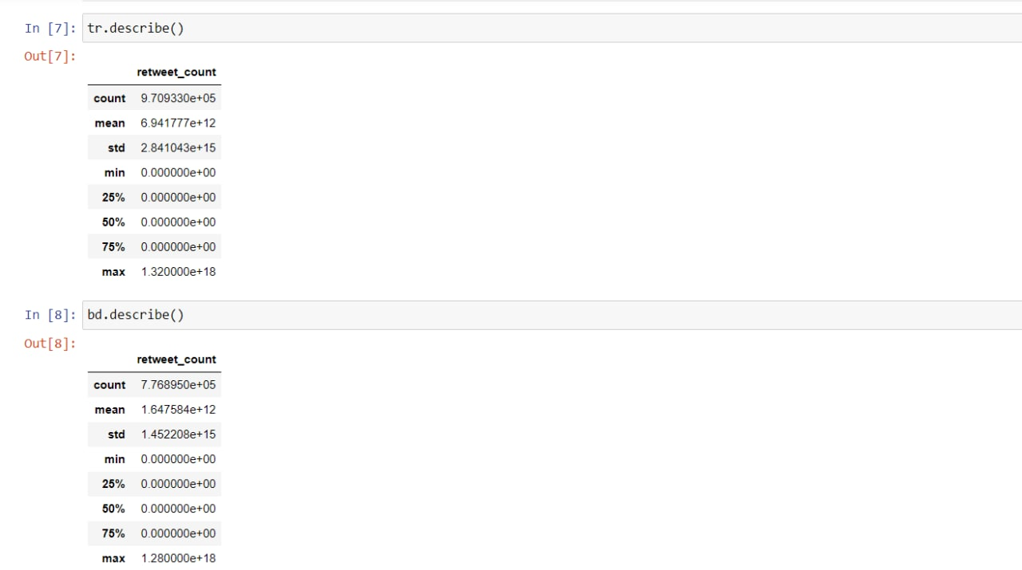
CODE IMPLEMENTATION

Slide 15
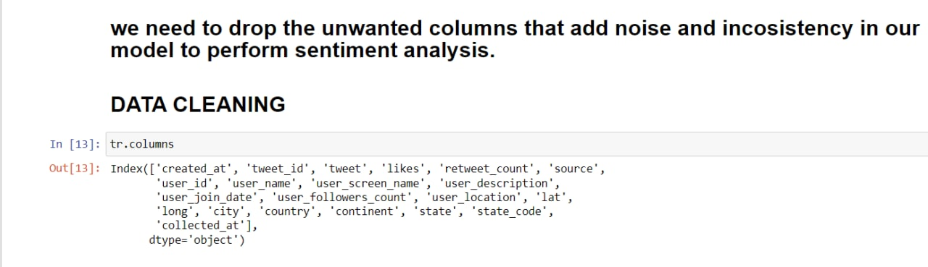
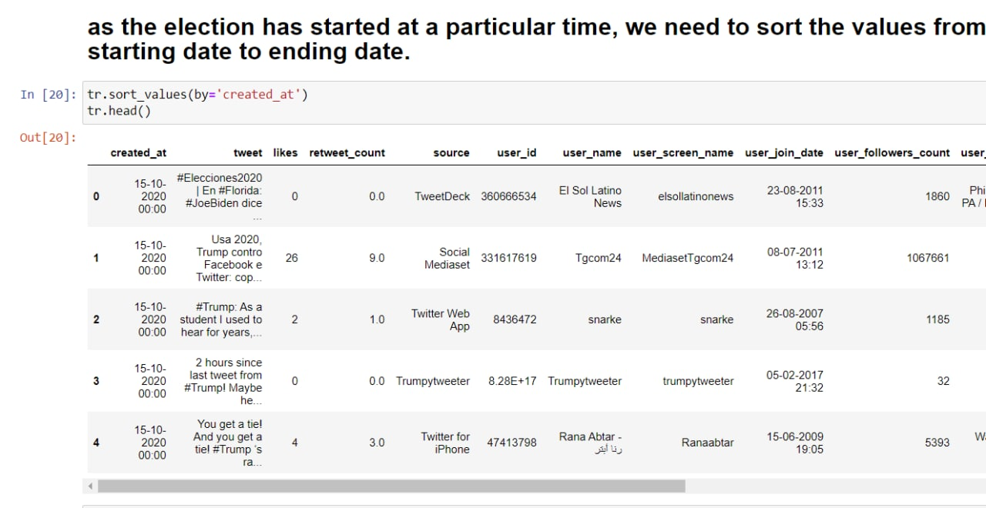
CODE IMPLEMENTATION

Slide 16
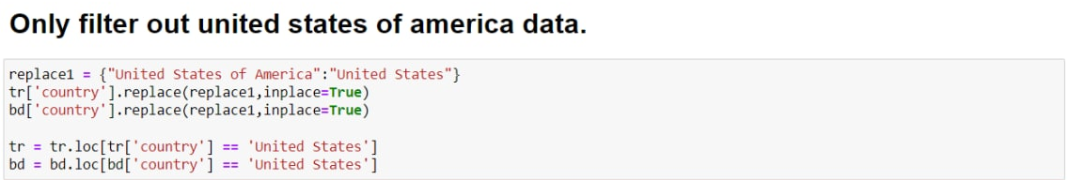
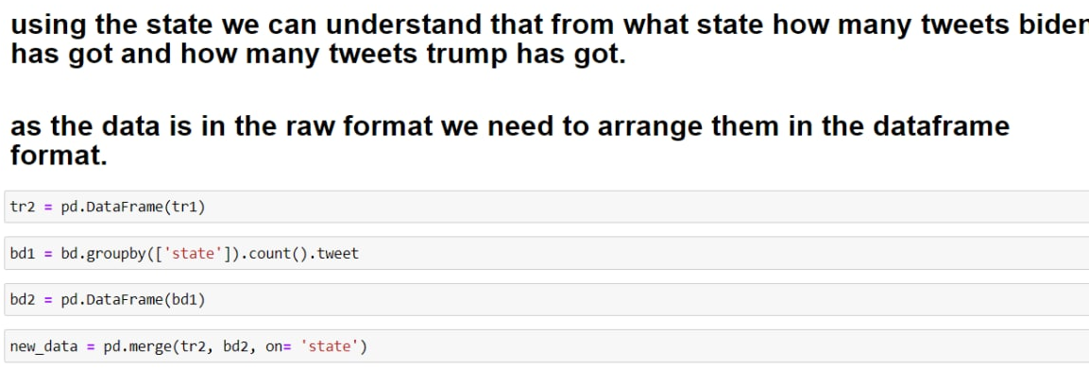
CODE IMPLEMENTATION

Slide 17
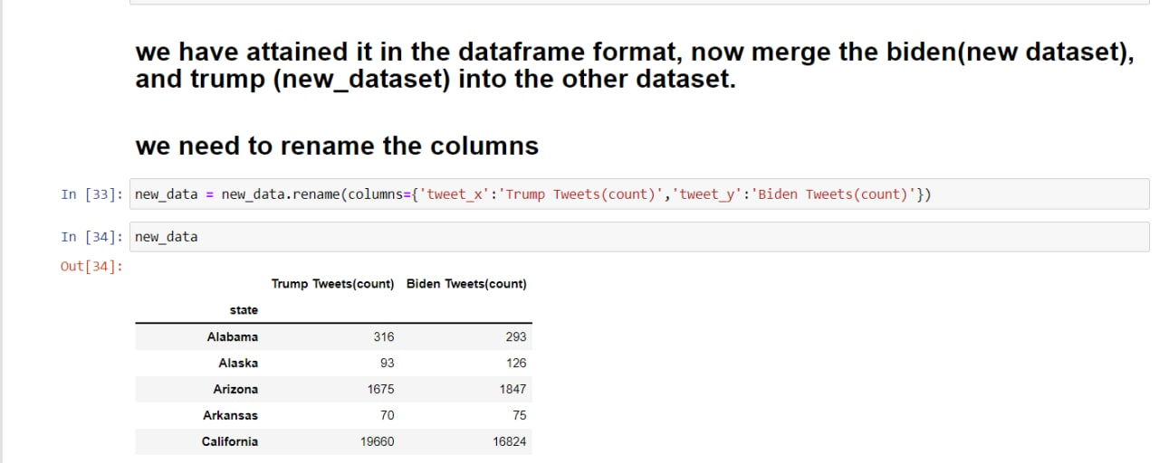
CODE IMPLEMENTATION

Slide 18
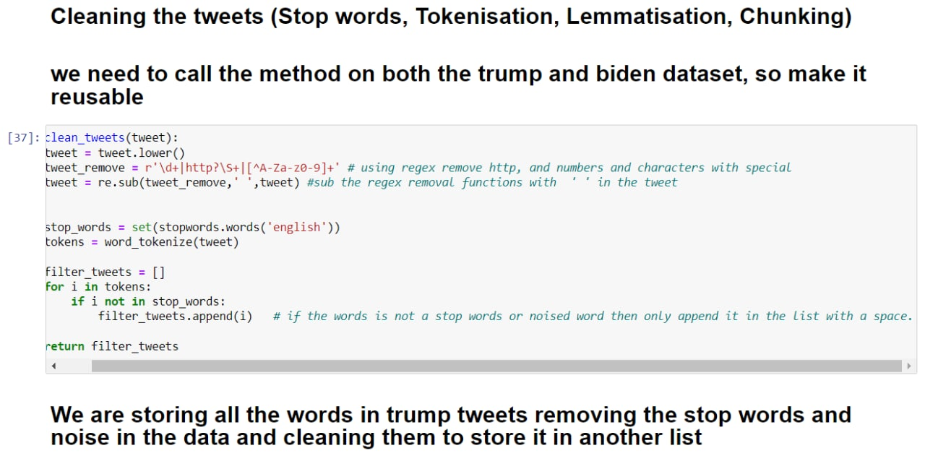
CODE IMPLEMENTATION

Slide 19
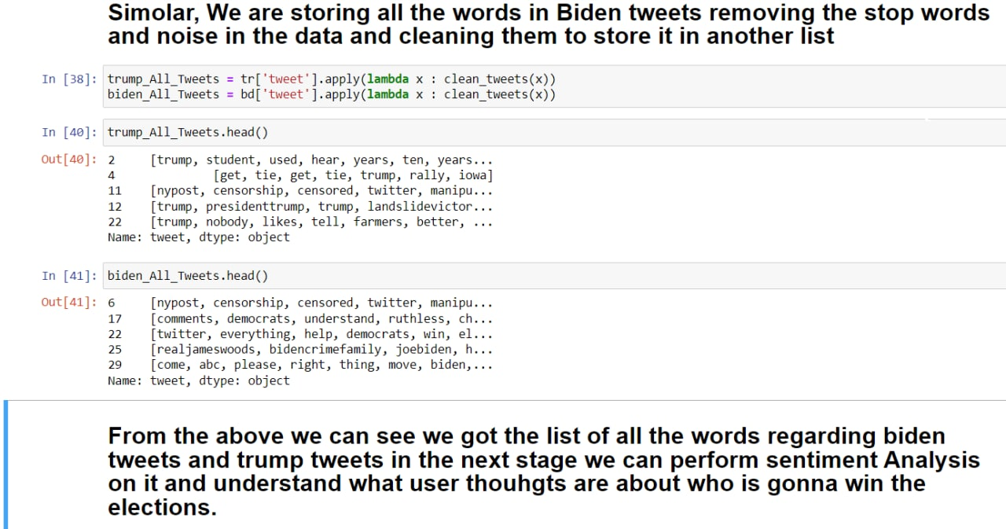
CODE IMPLEMENTATION

Slide 20
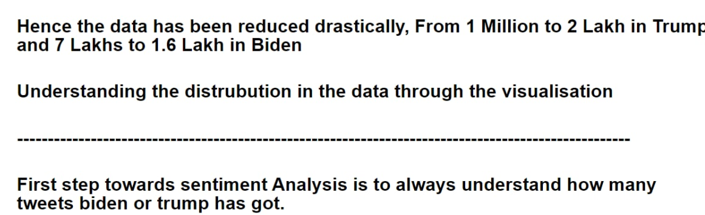
OUTPUT

Slide 21
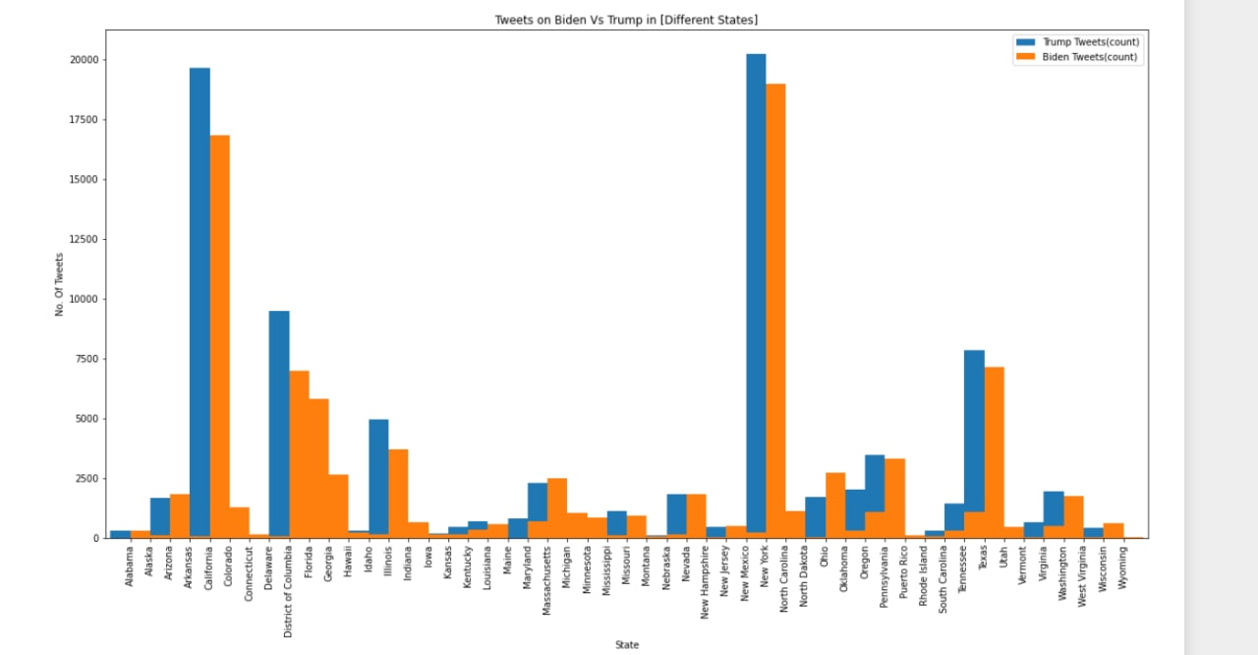
OUTPUT

Slide 22
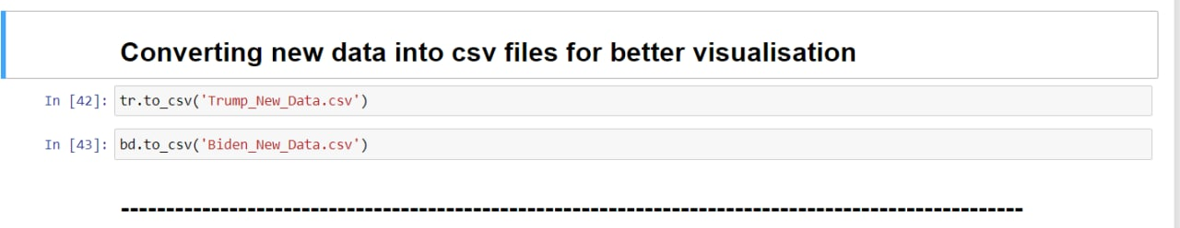
OUTPUT

Slide 23
GITHUB REPOSITORY
https://github.com/nihal136/Twitter_Sentiment_Analysis

Slide 24
CONCLUSION
This project will lead to better understanding of the result for US election for year 2020 on twitter which will be done using the tweets which will lead to good result prediction.

Slide 25
SUGGESTIONS

Slide 26
THANK YOU
Mentor: Dr. Arpita Gupta

